Slide 1
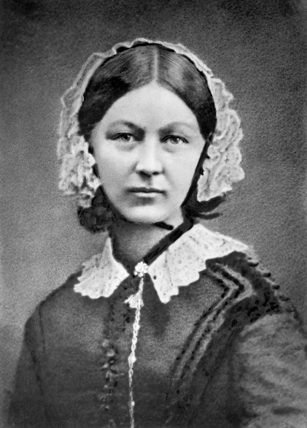
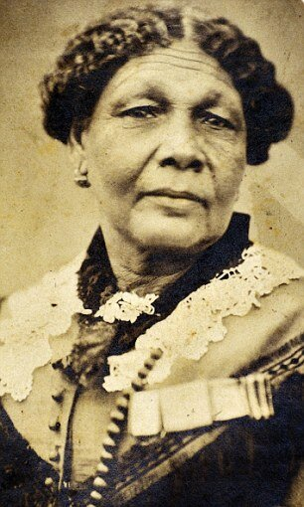
KS1 History (People who help us)
Sticky knowledge:
Mary Seacole and Florence Nightingale were both nurses who helped soldiers during the Crimean War.
Florence Nightingale made lots of changes to nursing. She cared for people at night (that’s why she was named the lady with the lamp). She also made sure people washed their hands and kept hospitals clean.
Florence Nightingale received a British Royal Red Cross for her work, whereas Mary Seacole did not.
Florence Nightingale (1820-1910)
Mary Seacole (1805-1881)

